Slide 1

Professional Ethics

Slide 2
Always remember and have foundation of :
“Do not have an eye on flaws of others but take note of good practices of others”
Or
“Keep an eye on flaws of own and replace these with good practices of others “

Slide 3
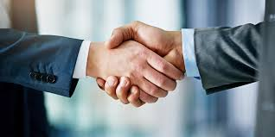
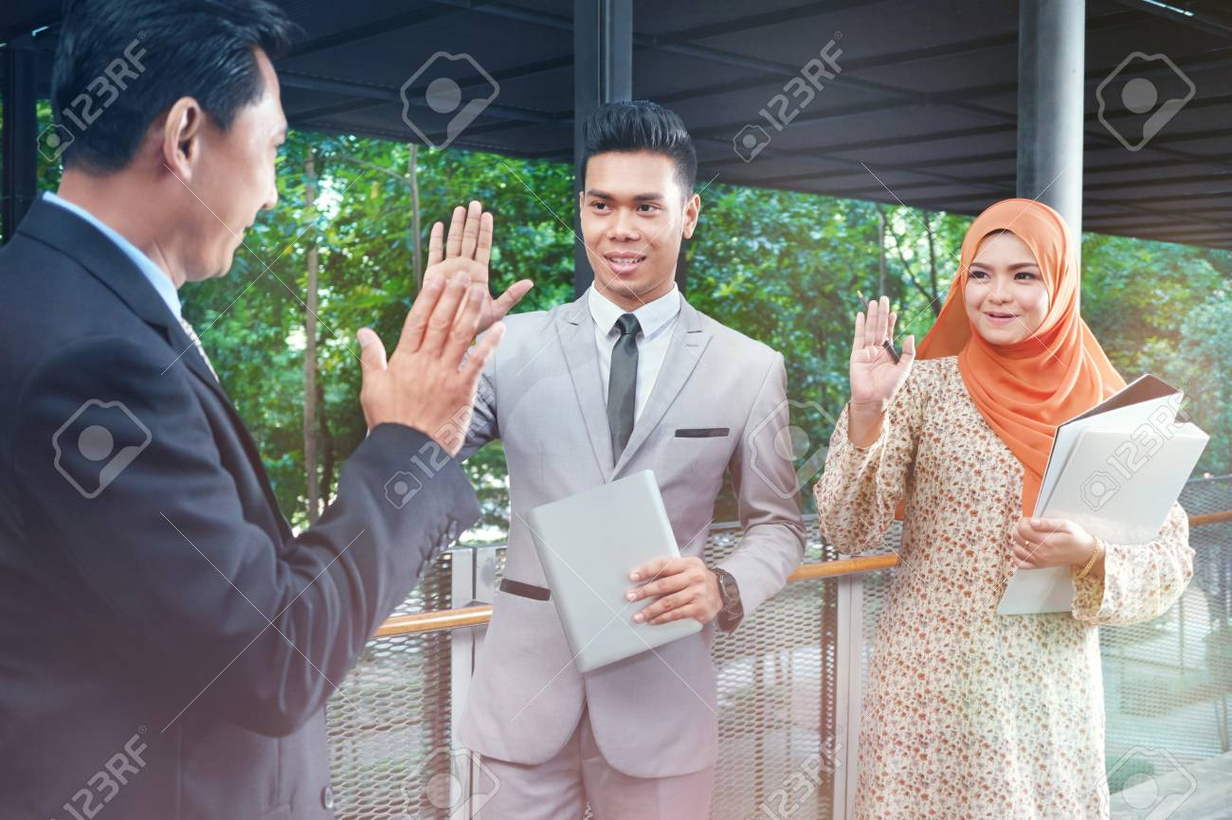
1. How to meet and leave
Say SALAM and shake hand while meeting and leaving
What about entering and leaving during an event?

Slide 4
2. Communication Etiquettes and Manners
Time Availability
Phone at least one hour (Informal communication)
SMS / WhatsApp 4 hours (Informal communication)
Email 48 hours (Formal communication)
Hard Copy letter 72 hours (Formal Communication)

Slide 5

2. Communication Etiquettes and Manners
Formal Written communication
Use formal and courteous language
Appropriate use of solicitude
Receive and give acknowledgement
Timing
Follow-up

Slide 6

2. Communication Etiquettes and Manners
Formal Speaking
When asked then speak
Use formal and courteous language
Use appropriate solicitude
How to interrupt
How to criticize
How to appreciate (avoid exaggeration)
Avoid show off

Slide 7
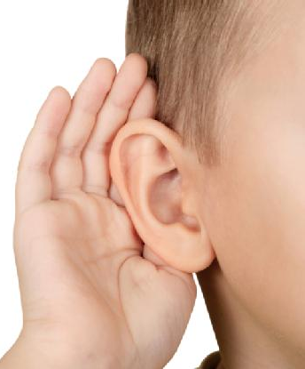
2. Communication Etiquettes and Manners
Listening
The most difficult skill
Show complete attention
Give affirmations at appropriate points
Use your expressions accordingly
Feeling must be expressed that you are
listening attentively

Slide 8

2. Communication Etiquettes and Manners
Useful resources to improve communication skills
Book Reading
Listening of good speaker
Watching of good movies
Travelling
Get training of communication skills
Observation

Slide 9
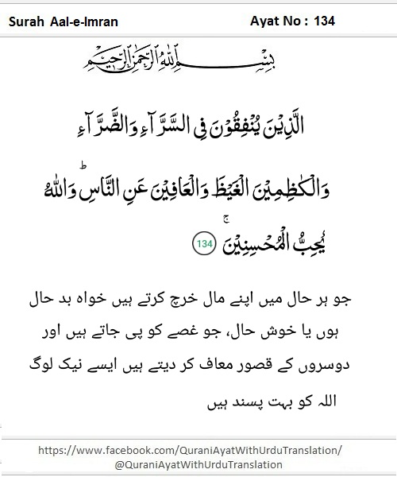
3. Anger Management:
What is anger?
Reaction to action
Good or bad?
Intensity of anger is driven by ‘attitude’

Slide 10
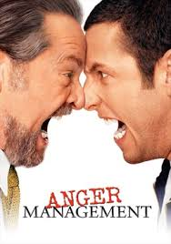

3. Anger Management:
To manage anger:
Proactive approach
Develop good attitude
Positive thinking
Be clear about what is your related and what is not related

Slide 11
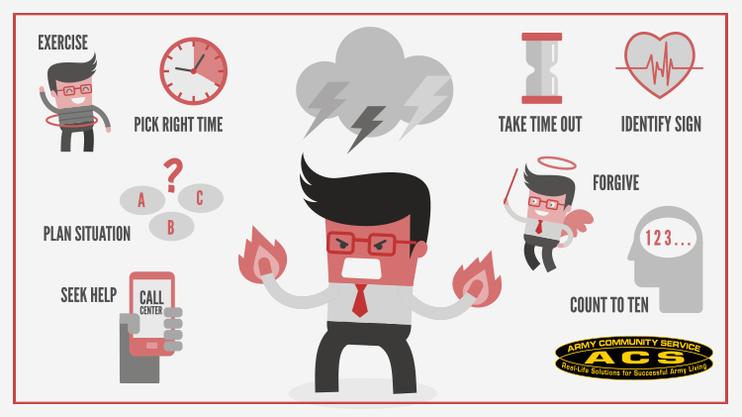
3. Anger Management:
Reactive approach
Base is to create a ‘distraction’
Don’t be ‘personal’
Change the topic
Change the posture
Drink water
Have ablution
Take bath
Leave the place
Overall
Give Forgiveness, Get Forgiveness

Slide 12
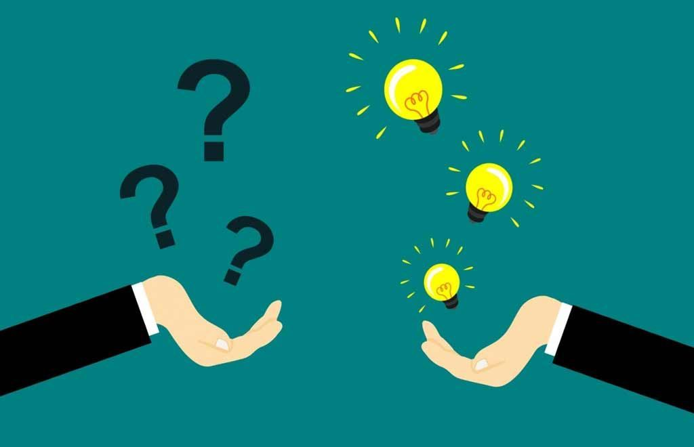
4. How to ask question:
Intention to ask question
Remember!
Knowledgeable and blessed person knows the intention

Slide 13
Thank You!

